Slide 1
BlueROV Electrical Block Diagram
DRAFT, 20160227
Not Needed??
6600 mAh 4s Lipo Battery
14.8vdc
Safety SW
Pressure Enclosure
XT90
XT90
3DR uBlox GPS with Compass
What is Best way to Tap into 5v pwr for PI – From Aux Outputs as shown on sht 3?
+14.8 vdc
XT60
XT60
3DR Power Module
Power
5 vdc
Mot SW
GPS
XT60
3DR Pixhawk
Autopilot
BatPwr In
JST-XH
+14.8 vdc
XT60
Power 5 vdc
1.2A
Main ESC PWM
Thruster Ctrl
Buzzer
Raspberry Pi 2
Model B
Raspberry Pi Camera Board
JST-XH
……6x…..
JST-XH
Terminal Board
Terminal Board
+14.8 vdc
Gnd
Buzzer
Ctrl / Data
Ethernet Tether
Basic 30A ESC
ESCs ……6x…..
Basic 30A ESC
Not Needed??
T200 Thruster
T200 Thruster
Topside (Laptop)
Thrusters ……6x…..

Slide 2
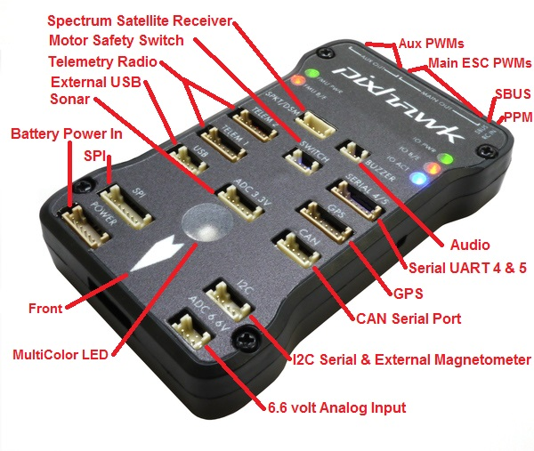
Pixhawk Overview
Ref: http://copter.ardupilot.com/wiki/common-pixhawk-overview/

Slide 3
Pixhawk connector assignments
Pwr Input (from module)
Thruster Enable ????
Warning Buzzer ????
Signal from GPS/Compass
ESC - PWM
Rasp. PI +5v / - Gnd.
Ref: http://copter.ardupilot.com/wiki/common-pixhawk-overview/

Slide 4
3DR Power Module This page explains how to set up the 3DR Power Module (PM) to measure battery voltage and current consumption. The information will also be useful for setting up other types of Power Module.
XT60 Connector
To Terminal Board +/Gnd
To Pixhawk Power Input Conn.
Ref: http://copter.ardupilot.com/wiki/common-3dr-power-module/

Slide 5
3DR UBlox GPS + Compass Module This page covers the installation of the 3DR UBlox GPS + Compass module.
Ref: http://copter.ardupilot.com/wiki/common-installing-3dr-ublox-gps-compass-module/

Slide 6
