Slide 1
BlueROV Electronics and Controls Documentation
Original presentation: https://www.bluerobotics.com/wp-content/uploads/2016/03/BlueROV-Block-Diagram-20160318.pptx
Original forum post: https://www.bluerobotics.com/forums/topic/bluerov-interconnect-diagram/
The AUV Laboratory at MIT Sea Grant
June 24, 2016

Slide 2
BlueROV Electrical Interconnect Block Diagram
BlueRoboticsPressure / Temp. Sensor
6600 mAh 4s Lipo Battery
14.8vdc
XT90
XT90
I2C Expander
+14.8V
XT60
XT60
3DR Power Module
Power
5V DC
I2C
GPS
XT60
3DR Pixhawk
Autopilot
JST-XH
Raspberry Pi 3
BatPwr In
Ctrl / Data
Ethernet Tether
Topside (Laptop)
Pressure Enclosure
+14.8V
XT60
GPIO15, 14, GND
Buzzer
Raspberry Pi Camera Board
Xbox Controller
Terminal Board
Terminal Board
Main ESC PWM
Thruster Ctrl
TELEM 2
5V/GND Pins
+14.8V DC
Gnd
JST-XH
Main
Outputs
……6x….
JST-XH
Buzzer
(Optional)
Output 5V
UBEC
Basic 30A ESC
ESCs ……6x…..
Basic 30A ESC
Input 14.8V
T200 Thruster
Thrusters ……6x…..
T200 Thruster
20160624

Slide 3
Controls Interface
On-Board
Topside
Sensors
3DR Pixhawk
Autopilot
Raspberry Pi 3
Laptop
Ethernet
Tether
Telem2
QGroundControl
Xbox Controller
ArduSub
ESCs
Pi Cam
Video Feed
Sensor Data
Manual Control
Parameters and Position updates
This is the controls interface for the final ROV setup.

Slide 4
Controls Interface- Testing
Sensors
SSH (VM)
3DR Pixhawk
Autopilot
Raspberry Pi 3
Video Feed
Telem2
SSH (Mac or PC)
Ubuntu VM (PC)
ArduSub
ESCs
Pi Cam
Laptop (PC or Mac)
This is the setup used while testing different components and software packages. Different arrangements could be more compact, but this is what was available and fastest to set up without Ethernet at the time.
Both Mac and PC were used for testing, but unless otherwise noted the interface remained the same between both platforms. An Ubuntu virtual machine on VMware was used for the PC. PuTTY saves time on the PC for SSH without booting the virtual machine.
QGroundControl
Xbox Controller
Video Feed (Mac)
Sensor Data
Manual Control
Parameters and Position updates

Slide 5
Software Summary List of all sites consulted for software downloads, some of the links may be redundant.
https://www.bluerobotics.com/forums/topic/radio-calibration/
http://ardusub.com/initial-setup/#install-qgroundcontrol
https://github.com/mavlink/qgroundcontrol/releases/tag/v2.9.7b
http://firmware.ardusub.com/Sub/latest/
https://www.bluerobotics.com/forums/topic/bluerov-ros-package-updates/
https://www.bluerobotics.com/forums/topic/problem-with-running-bluerov/
http://www.ros.org/install/
Common error fixes
RC3_MAX and RC3_MIN change to 2200 and 800 – fixes joystick/radio calibrating
Change baud rate and a few other parameters listed here http://ardusub.com/initial-setup/#configuring-parameters
ssh into bluerov raspi when simplerov frame is installed on Pixhawk, and UDP com port on qgroundcontrol is 14550: sudo -s mavproxy.py --master=/dev/ttyAMA0 --baudrate 57600 --out LAPTOP_IP_ADDRESS:14550 --aircraft simplerov
If connection times out and mavproxy.py still running: sudo –s pkill mavproxy.py

Slide 6
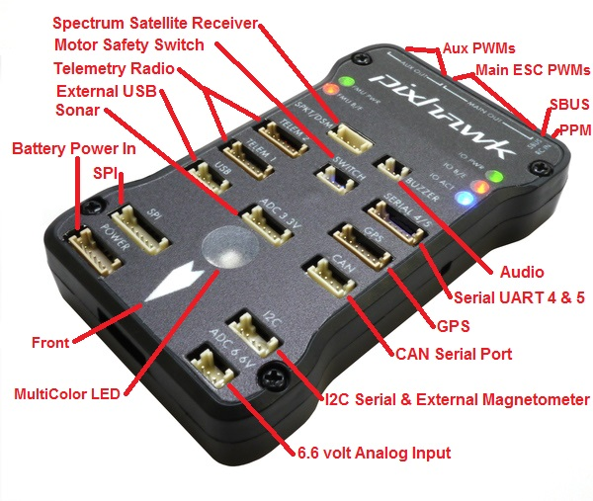
Pi Data connects to Pixhawk via Telem 2
Pixhawk Overview
Connect ESCs Control 1-6 Here
Connect 3DR Power Module Pigtail Here
Buzzer (Optional)
Connect I2C Expander
Then connect Pressure Sensor and BlueRobotics Depth Sensor to Expander
http://copter.ardupilot.com/wiki/common-pixhawk-overview/

Slide 7
Pixhawk connector assignments
Comms (to Rasp. Pi3)
Pwr Input (from module)
Warning Buzzer (optional)
Connect I2c Expander which is connected to Pressure sensor and Bluerobotics depth/temp. sensor
Thruster ESCs - PWM
http://copter.ardupilot.com/wiki/common-pixhawk-overview/

Slide 8
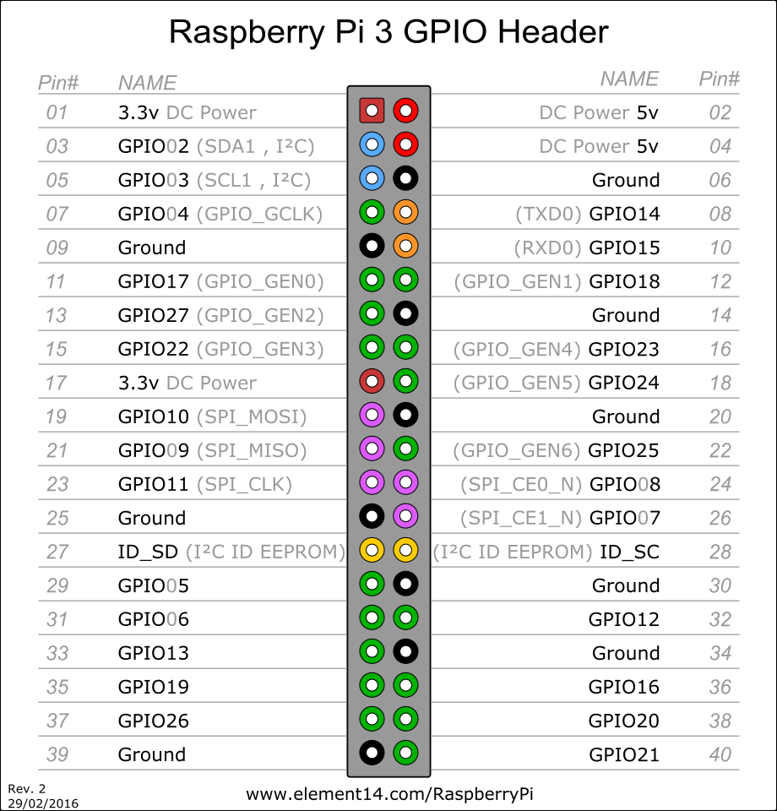
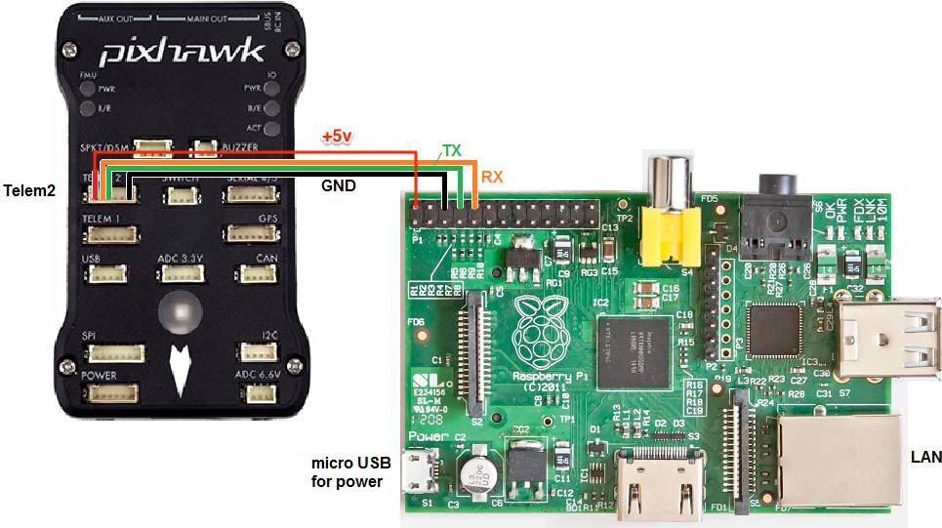
Raspberry Pi Connectors The pins are labeled in a confusing manner, so this page is to clarify the connections necessary to run the Pixhawk and Raspberry Pi together.
UBEC 5V
UBEC GND
Telem2 #3
Telem2 #2
Telem2 #6
http://tr1.cbsistatic.com/hub/i/2016/03/03/53945d8c-6ec9-4a2a-922a-6df3b2a5c372/img4085.jpg, http://ardupilot.org/dev/_images/RaspberryPi_Pixhawk_wiring1.jpg

Slide 9
3DR Power Module This page explains how to set up the 3DR Power Module (PM) to measure battery voltage and current consumption. The information will also be useful for setting up other types of Power Module.
To BlueROV
Terminal Board +/Gnd
XT60 Connector
3DR Power Module
3DR Power Module-
Reverse Side
+5vdc
To Pixhawk Power Input Conn.
Gnd
http://copter.ardupilot.com/wiki/common-3dr-power-module/

Slide 10
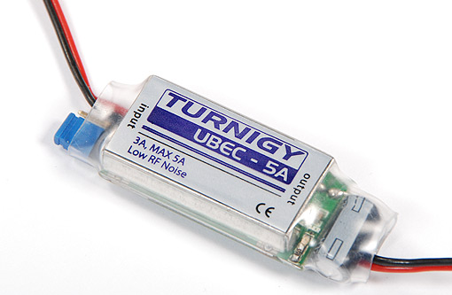
UBEC This page explains how to set up the 3A-6s UBEC Voltage regulator to power Raspberry Pi from LiPo safely.
Turnigy UBEC-5A
Input
To BlueROV
Terminal Board +/-
To Raspberry Pi 5V and Gnd pins
Output
http://www.brontoseno.com/kategori-produk/sbecubec/

Slide 11
ESC Connections
Motor directions determined by output phase, exact wiring not known until tested
5V not needed, cut the connections to avoid overheating
http://docs.bluerobotics.com/assets/images/documentation/besc-labels.png

Slide 12
OPTION - Bluerobotics Lumen Light(s)
PIX
Aux
Connect the Signal wire and Ground to Aux Output on Pixhawk ***
(Appropriate microcontroller pin for Brightness Control)
Yellow: PWM (3-48 volts)
Provide a servo PWM pulse from 1100 μs (off) to 1900 μs (brightest)
Connect the power wires to power Terminal Board
Red: +10-48 volts
Black: Ground
Lumen
Light
Yellow: PWM (3-48 volts)
Red: +10-48 volts
Black: Ground
Lumen
Light
Additional Lights can be connected in Daisy Chain Fashion
https://www.bluerobotics.com/store/electronics/lumen-light-r1/
http://ardusub.com/initial-setup/#lights-setup
***Lights Setup
The lights feature is currently setup to support lights that use a standard servo PWM signal for control. Until light support is officially added to QGC, the “Gimbal Roll” settings are used to connect the light input to a servo output.
Select an available channel for the “Output channel” and RC9 for the “Input channel”.

Slide 13
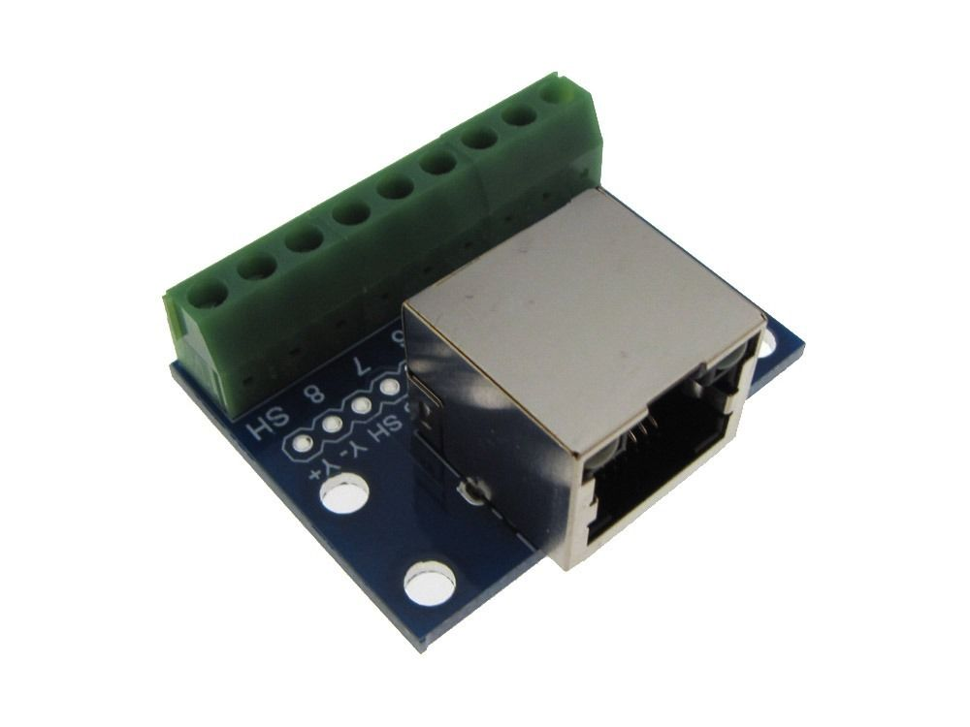
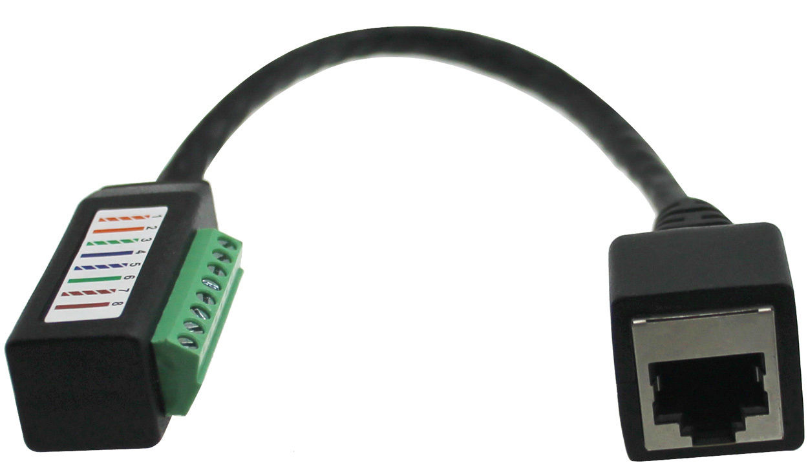
OPTION - Use of an Ethernet Breakout to allow removal / replacement of penetrator from endcap without cutting wires.

Slide 14
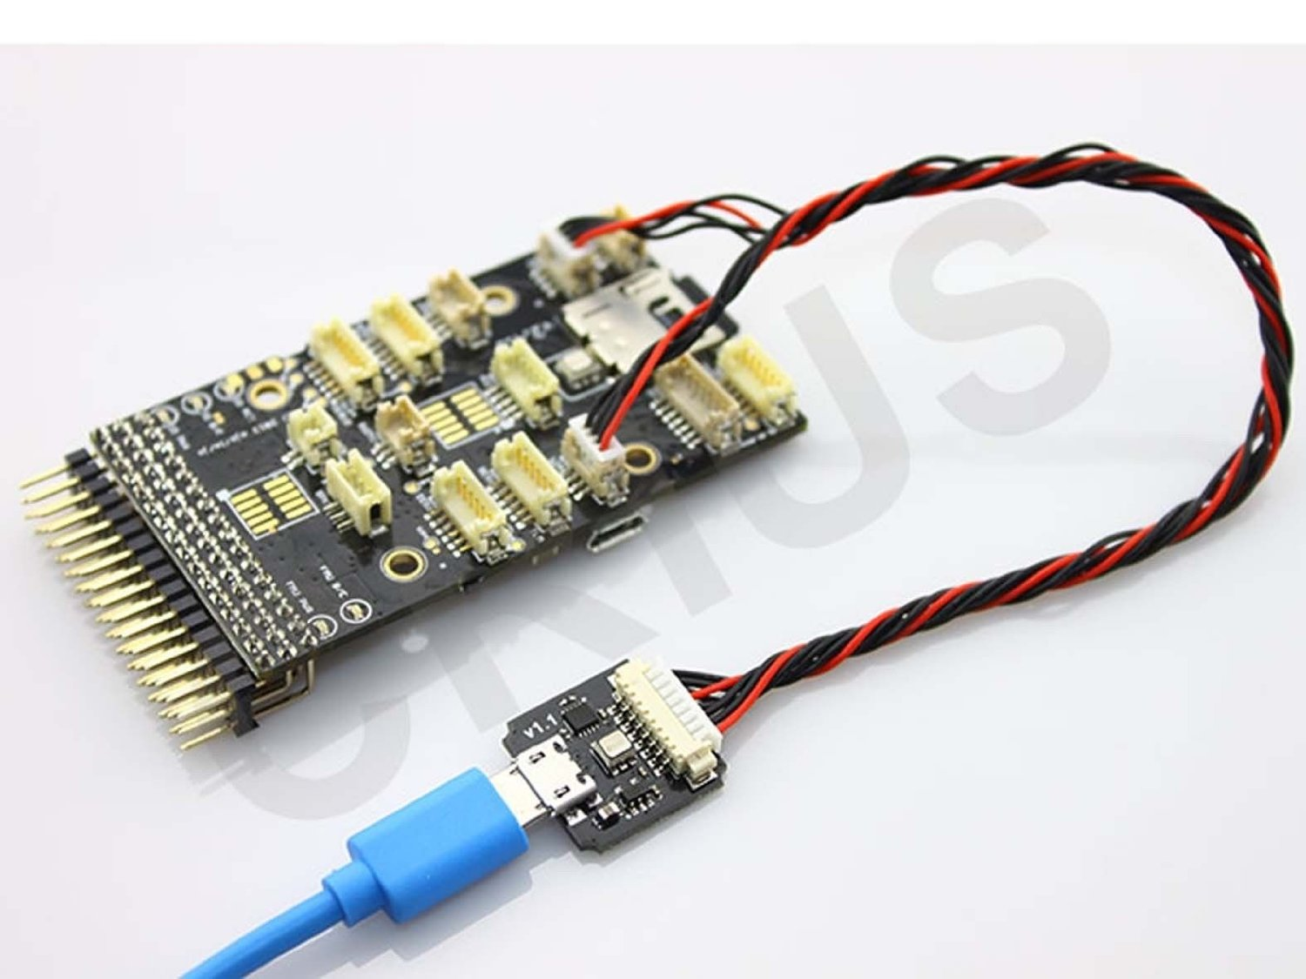
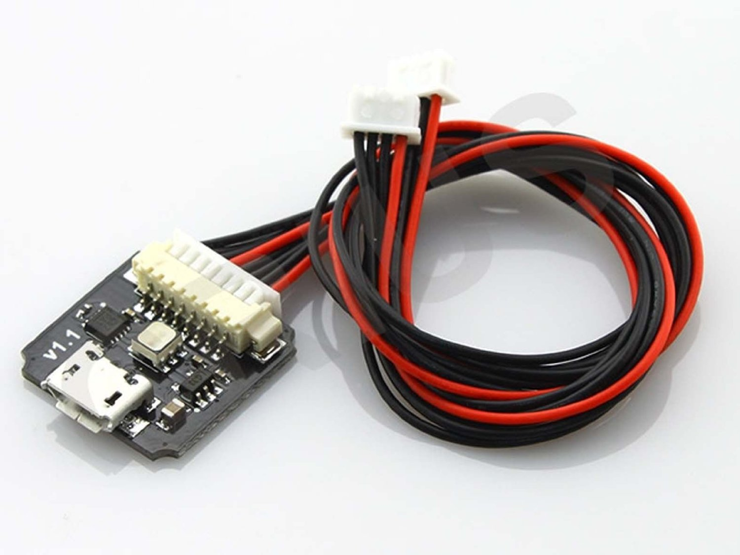
OPTIONAL - Adaptor for USB Connection Between Pixhawk and Pi
We found that direct USB connectionfrom Rasberry Pi to Micro USB connector on side of 3DR Pixhawk was unreliable so we used the following interface circuit to make the connection
Crius RGB External LED Indicator USB Module for Pixhawk Flight Controller
http://www.amazon.com/Crius-External-Indicator-Pixhawk-Controller/dp/B00LAV9VLM?ie=UTF8&psc=1&redirect=true&ref_=oh_aui_detailpage_o01_s00

Slide 15
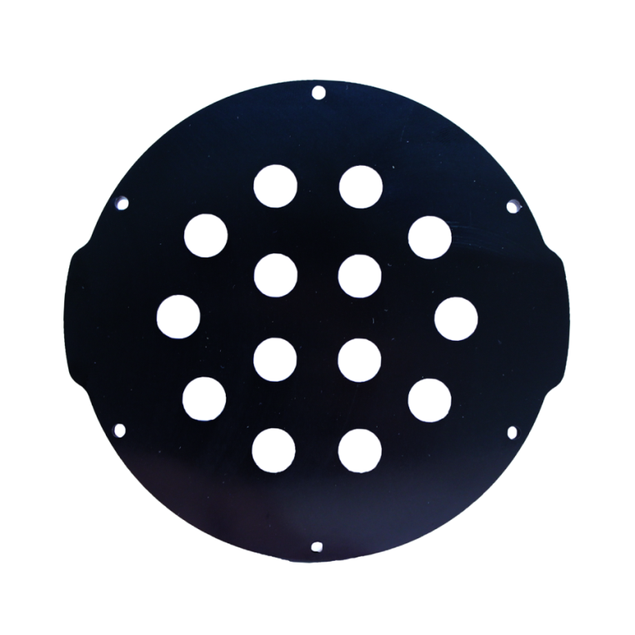
Penetrators
End Cap with 10 Holes (4″ Series)
Original Configuration
Main (4”) Enclosure (10 Holes)
Vent/Purge
Thruster 1
Thruster 2
Thruster 3
Thruster 4
Thruster 5
Thruster 6
Tether
Pressure/Temp
LED Light
No Spares
All Penetrators locations are interchangeable
Note: 14-hole Endcap is Available from Blue Robotics
Aluminum End Cap with 14 Holes (4″ Series)

Slide 16
Comments:
The “safety sw” is currently disabled in our recommended
Changes have been made to diagram to power Raspberry Pi separately from Pixhawk
ESC 5V connections removed by rec.
GPS/Compass removed because ocean water
Slides 1, 3, 4, 5, 8, 10, 11 added for clarity

Slide 17
Additional Sources
https://www.bluerobotics.com/wp-content/uploads/2016/06/Diagram-Mockup-Ethernet.jpg
https://www.bluerobotics.com/forums/
http://ardupilot.org/dev/docs/raspberry-pi-via-mavlink.html
http://ardusub.com/initial-setup/#configuring-parameters
https://www.bluerobotics.com/forums/topic/radio-calibration/

Slide 18
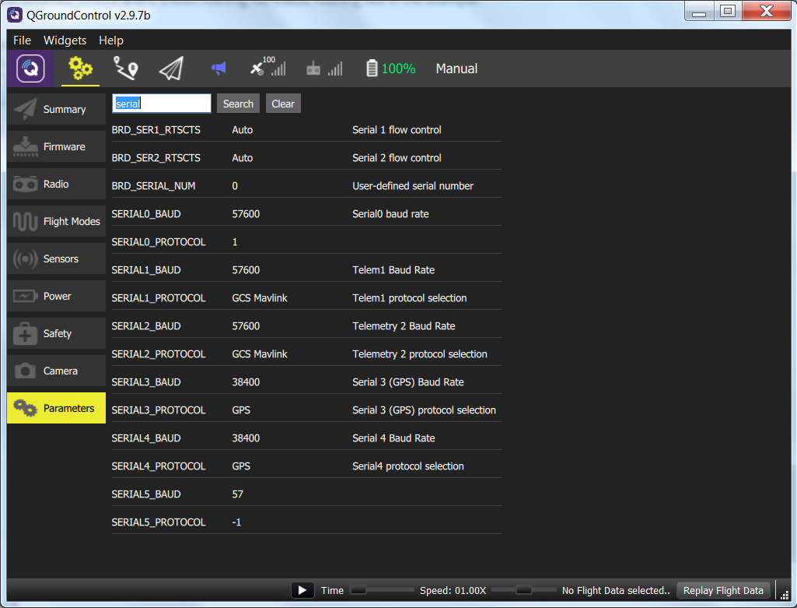
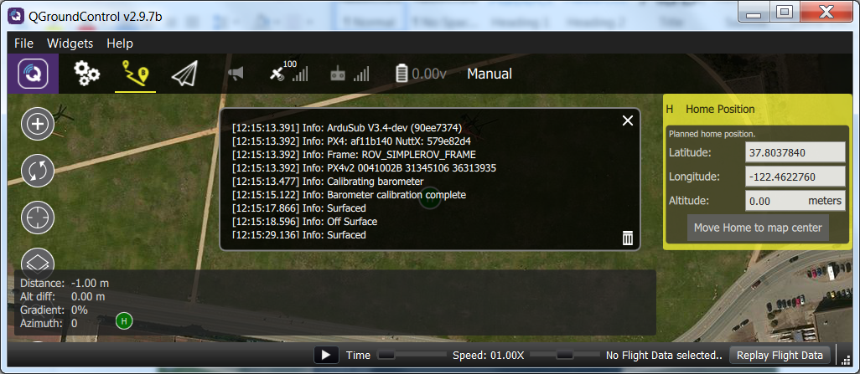
Additional Images

Slide 19
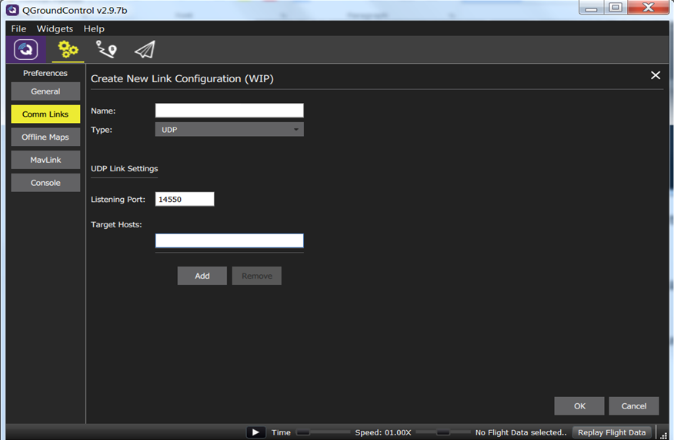
Additional Images

